Slide 1
ASE Lab-1
CH.Ravindra
Y.Pavan kumar

Slide 2
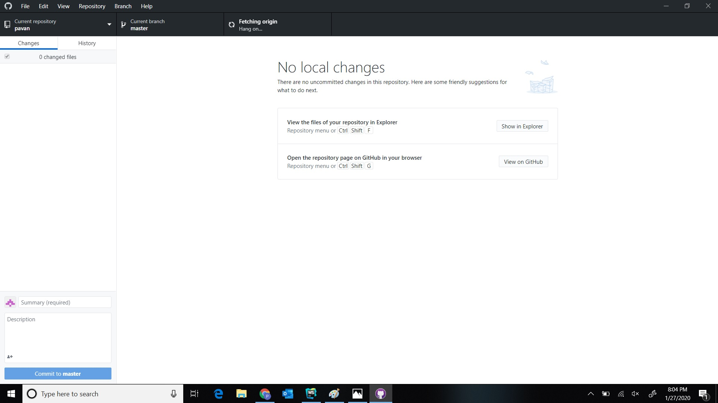
1.Git Hub Desktop

Slide 3
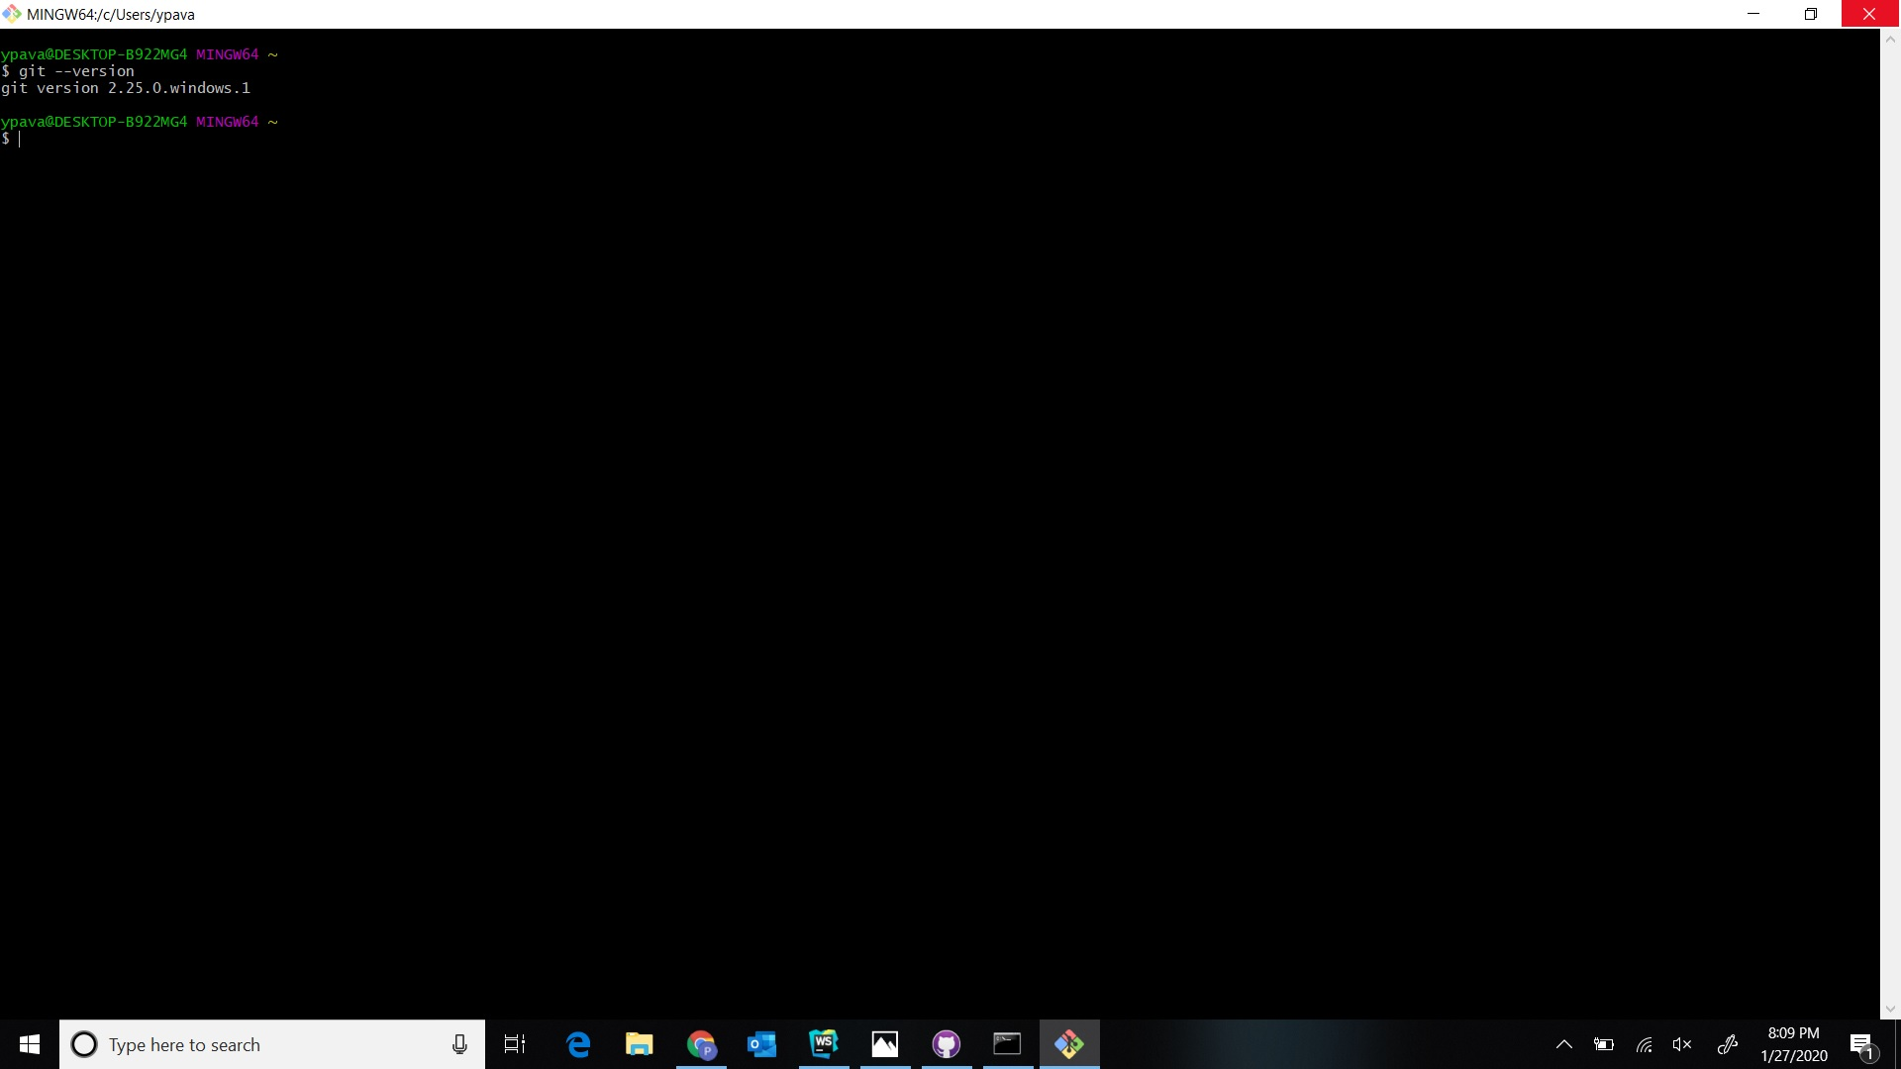
2.Git Shell

Slide 4
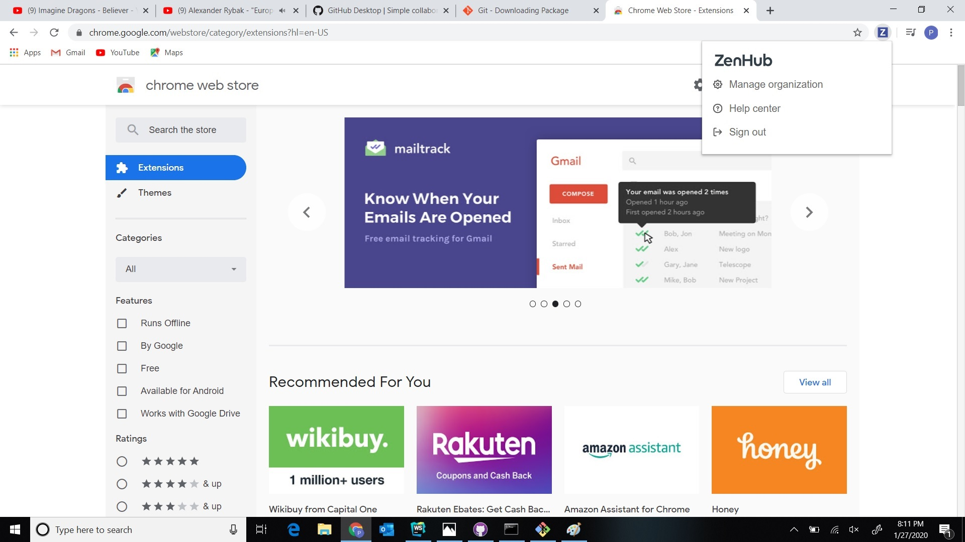
3.Zen Hub

Slide 5
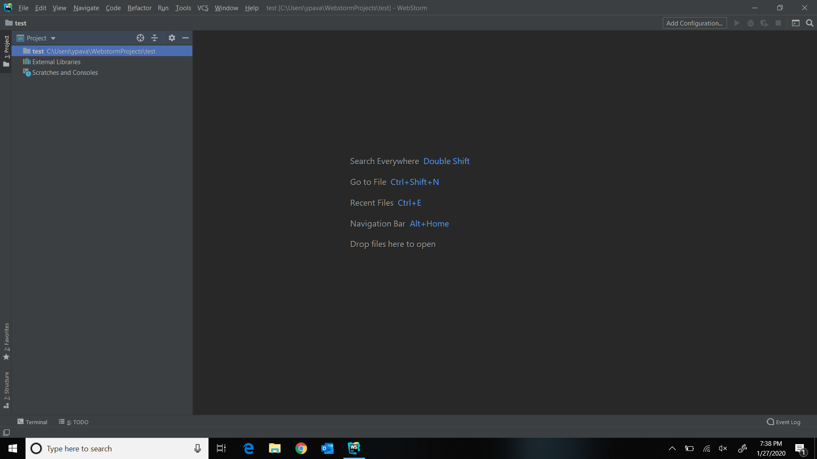
4.WEB STORM

Slide 6
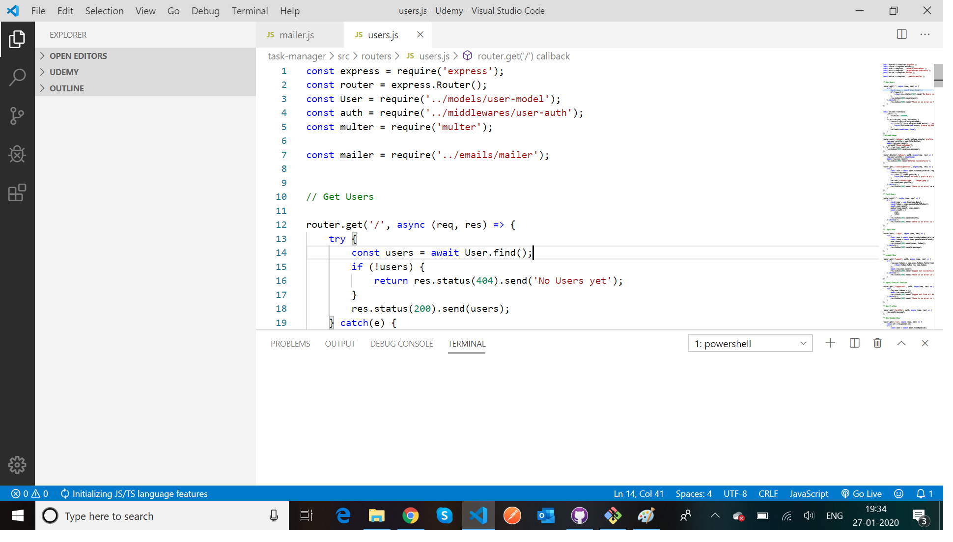
Visual Studio

Slide 7
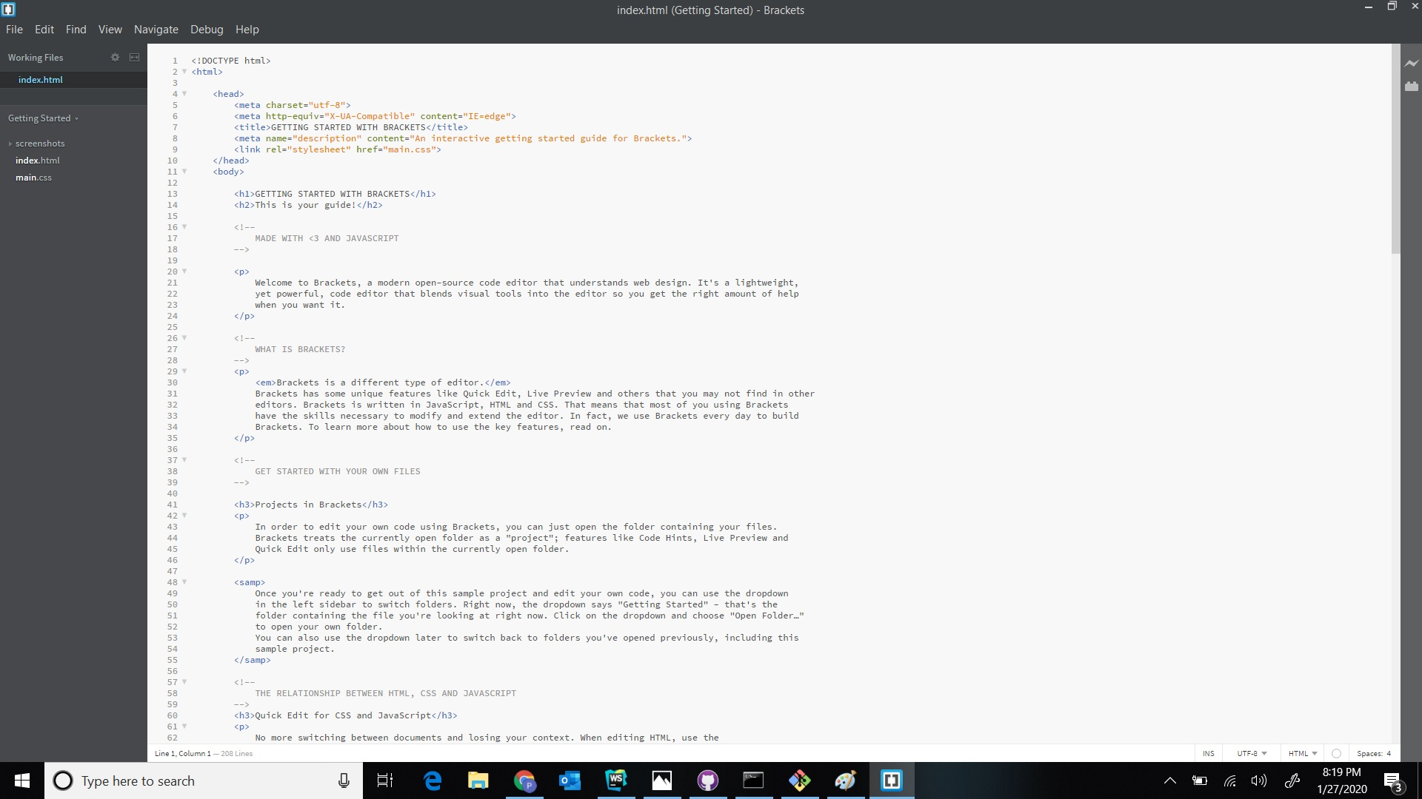
5.BRACKETS

Slide 8
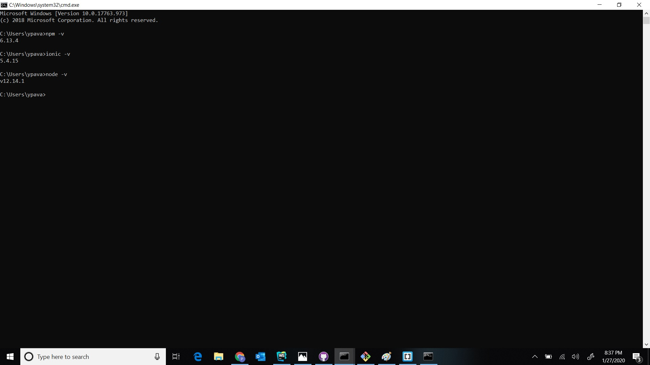
7.NODE

Slide 9
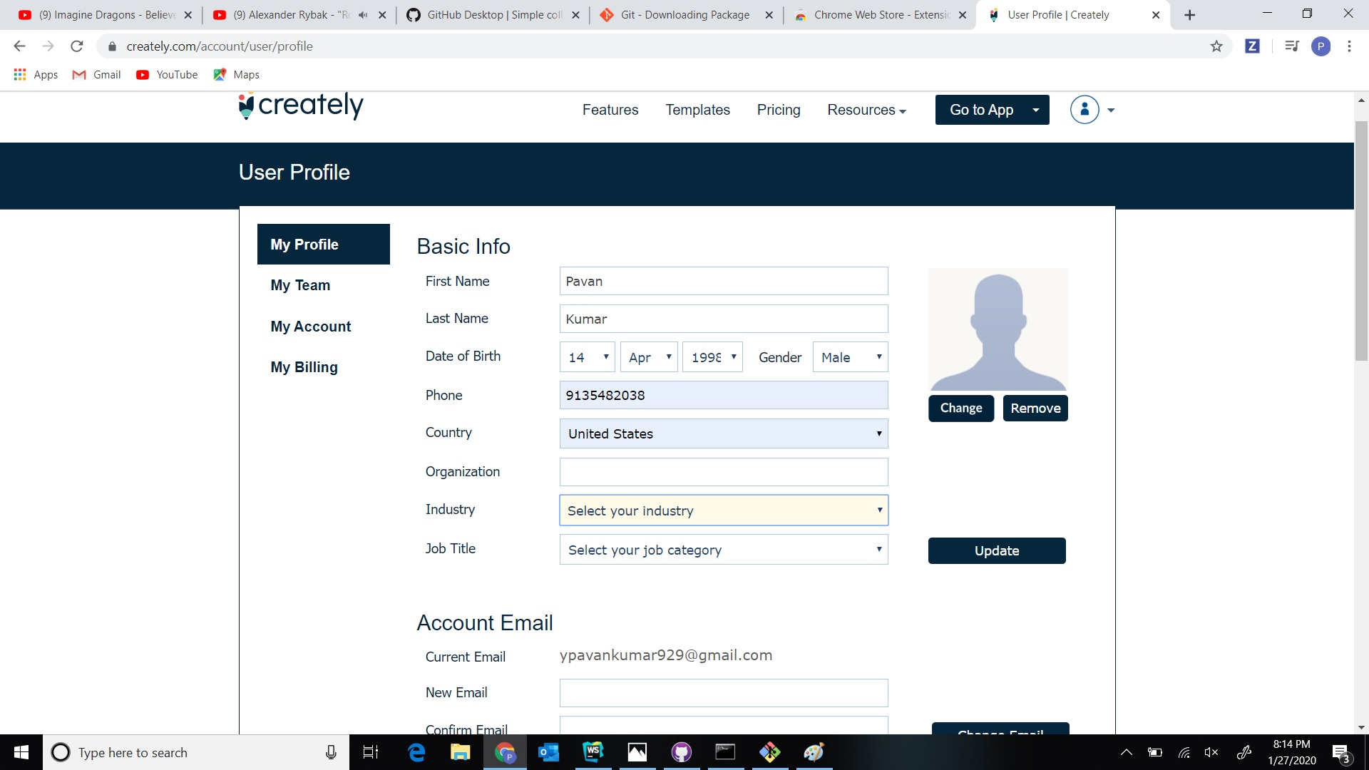
6.CREATLY

